Slide 1
Environment and
RESPONSIBILITY

Slide 2
What is to be responsible?
Being responsible means you do the things you are expected to do and accept the consequences (results) of your actions.

Slide 3
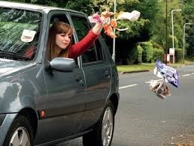
Look at this example….
What happens when people are don’t act responsibly?
When people are not responsible, it affects everyone!!!

Slide 4
Our planet, Our responsibility
https://youtu.be/bn8R_XqjjI0

Slide 5
Eco Warriors
We are the Eco- Warriors!
We are working together to make our school greener and to make our future better.
We want to help children and teachers to be more RESPONSIBLE with the school and the environment.

Slide 6
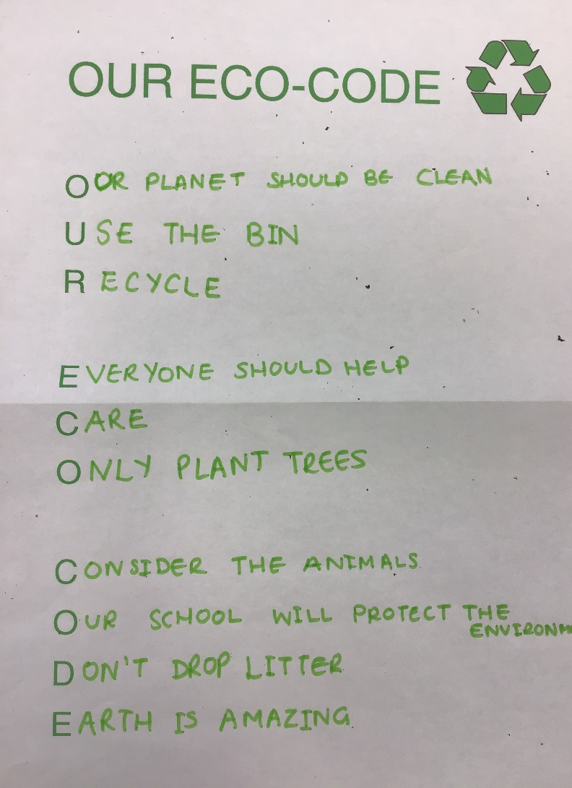
Our Eco-Code
We worked together to come up with an Eco-Code.
This is our promise which tells others about how we are going to help the environment.

Slide 7
Environmental Review Results
Things we are doing well:
Some children are aware and reminded of the impact of our actions
We do lots of outdoor activities and we have good equipment
Lots of us walk to school every day
We do daily exercise- mile a day
We have healthy meals and snacks
We have recycling bins in each classroom
Our school environment is generally clean and litter-free

Slide 8
Environmental Review Results
Things we could do better:
Be more aware of our wildlife in school grounds
Have more recycling bins around school
Participate in litter picks
Join recycling schemes (i.e. pens)
To have more outdoor lessons
Print less paper
Not to use paper towels / switch lights off when not using rooms
Grow a vegetable garden…
Respect school equipment more (pens, pencils, ipads…)

Slide 9
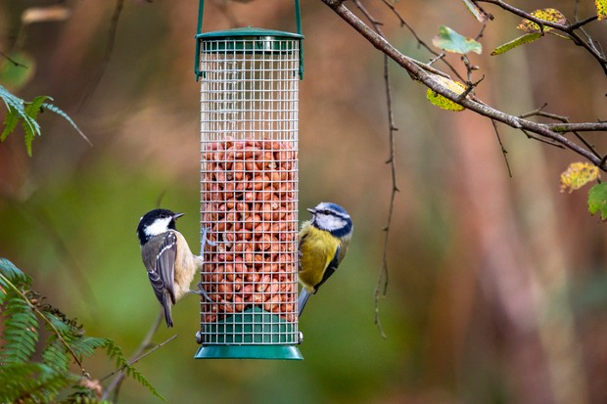
OUR ACTION PLAN
We want to focus waste and recycling and also helping the wildlife around our school environment.

Slide 10
Eco-Week
This week within school, we are going to have an Eco-Week. In your classes you will be taking part in activities using recyclable materials. We can’t wait to see your learning!

Slide 11
Thanks for listening!
And don’t forget to ACT REPONSIBLY!!!!

